Slide 1
Public Health Campaign for Patient Education on Antibiotic Necessity to Limit Overuse and Resistance
Group 5:
Ruthie Schreiber
Kliti Shentolli
Farhana Chowdhury
Maria Barak
Genna Giordano
Notes:
Ruthie

Slide 2
“Every year, doctors write an estimated 100 million antibiotic prescriptions for conditions they cannot treat. In part, that's because 36 percent of Americans incorrectly believe antibiotics are an effective treatment for viral infections...”
https://www.healthline.com/health/antibiotics/addiction-how-patient-demand-helps-drive-epidemic
“A survey of 1000 pediatricians found that half often felt pressure from patients' parents to prescribe antibiotics for illnesses not requiring antimicrobial therapy. Of greater concern, one-third of the pediatricians surveyed admitted that they generally comply with such requests, even in cases they believed did not warrant antibiotics. Two large studies of adult patients in family practice settings also clearly demonstrated that physicians are much more likely to prescribe medication when they thought the patient expected a prescription...”
https://journals.lww.com/em-news/Fulltext/2002/02000/Patients_who_Demand_Antibiotics_and_the_Doctors.12.aspx

Slide 3
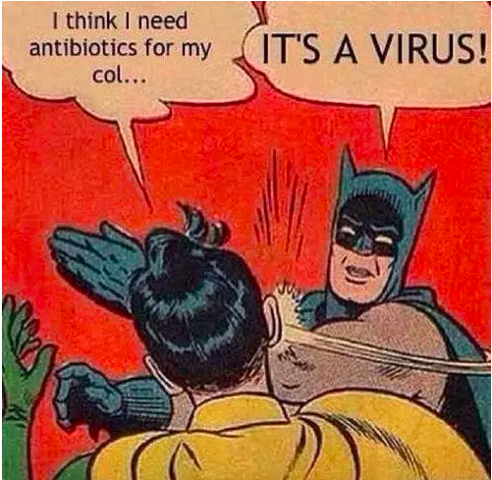
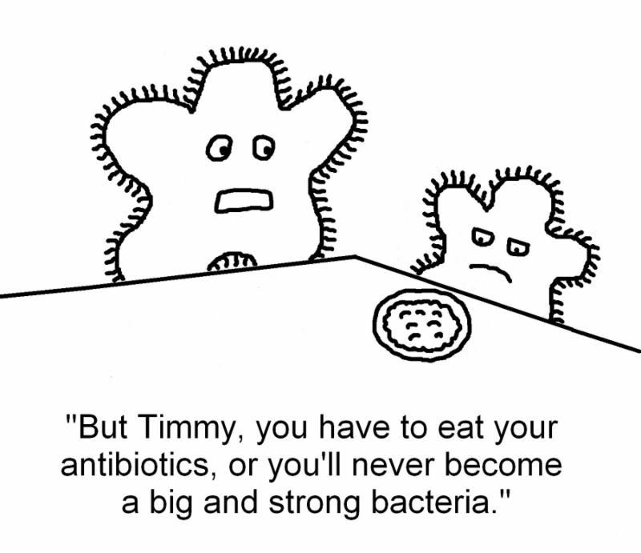
The Main Problem
-Lack of knowledge→ Lack of understanding
*Antibiotics= Bacterial (NOT VIRAL)*
-Patients: “Why can’t I use antibiotics to cure anything?!”
-Providers want to appease patients
Notes:
Ruthie

Slide 4
Antibiotics: History
-Penicillin (1928)
-The Golden Era of Antibiotics
Notes:
Ruthie
https://www.reactgroup.org/toolbox/understand/antibiotics/development-of-antibiotics-as-medicines/

Slide 5
Antibiotics: Actions & Classification
-Disruption of processes & structures of bacterium
~Bactericidal Antibiotics vs. Bacteriostatic Antibiotics
~Narrow-Spectrum Antibiotics vs. Broad-Spectrum Antibiotics
-Antibiotic Resistance
Notes:
Ruthie
https://www.reactgroup.org/toolbox/understand/antibiotics/how-do-antibiotics-work/

Slide 6
The Issue with Current Interventions
-”Wait-and-see”
-Lack of insurance reimbursement
-FDA
… but is it enough?
*Antibiotic Resistance= growing Public Health concern
*Shift focus from clinicians→educating the patients
Notes:
Ruthie
https://www.fda.gov/ForConsumers/ConsumerUpdates/ucm092810.htm

Slide 7
Who will benefit from our program?
-Clinicians
-Patients
-EVERYONE!
Notes:
Ruthie

Slide 8
Some ideal changes we would like to make
1) Behaviour changes
a) Patients’ behaviour:
Most patients are misinformed about the use and function of antibiotics.
It’s become a cultural and common belief that its ok to take antibiotics as treatment for almost every symptom.
“There’s no harm in taking antibiotics”.
There’s a lot of medical information out there for patients to access however, most medical texts on the web require the same reading level as that of a 10th grader. (Average reading level for U.S adults is equal to that of an 8th grader).
Notes:
Kliti

Slide 9
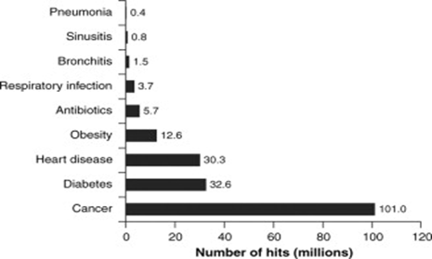
Volume of information of different medical conditions on the web.
https://www.sciencedirect.com/science/article/pii/S1198743X14613288
Notes:
Kliti

Slide 10
b) Physician’s behaviour:
According to Journal of the American Medical Association (JAMA), over 30% of antibiotics prescribed in the U.S are unnecessary, most of which are for respiratory conditions caused by viruses.
Why do physicians prescribe so many antibiotics then?
Patient satisfaction and pressure (avoid arguments, keep patients satisfied)
Time constraints (limited time, need to see more patients).
Decision fatigue (shortage of physicians, working longer hours, tired).
Uncertain diagnoses (sometimes you’re just not sure, decrease medical error, avoid lawsuits)
Notes:
Kliti

Slide 11
2) Environmental/social changes:
a) Cost:
Use of redundant antibiotics can drive up medical costs.
The cost nationwide from antibiotics alone is $163 million annually.
By avoiding unnecessary prescription of antibiotics, we can also decrease national spending on healthcare.
Notes:
Kliti

Slide 12
b) Agriculture:
Approximately, 70% of all medically important antibiotics in the United States are sold for use in animals and plants.
These antibiotics are given to healthy animals on a routine basis to prevent disease brought on by crowded, unsanitary conditions.
The FDA restricted the use of antibiotics for growth and production promotion in animals.
California passed “The Keep Antibiotics Effective Act”- stop the routine use of antibiotics for disease prevention purposes.
Notes:
Kliti

Slide 13
Plan on obtaining additional information within a certain population.
People who suffer from common cold, viral sore throats, bronchitis, and sinus and ear infections.
Send out surveys to that group to see how many of them believe that antibiotics should be the first treatment option in help with their current condition. How many believe otherwise.
Have these surveys available online, in doctors’ offices, hospitals, emergency rooms etc.
These surveys will tell us where specifically (location) to focus our educational efforts.
Notes:
Kliti how big the problem is and where specifically should we focus our efforts in.

Slide 14
2) Data collection from farmers.
Collect data on which animals receive them, which veterinarians prescribe them, or what diseases or infections they are intended to treat or prevent.
Collecting this type of data needs to be more controlled and not by sending surveys.
Benefit from STAAR Act (passed on March 1st, 2018)- strengthens existing federal investments in surveillance, data collection and research efforts to help prevent bacteria from developing resistance.
Notes:
Kliti

Slide 15
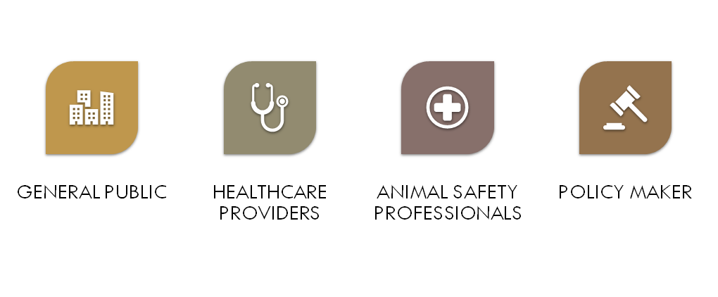
Few Key stakeholders
http://www.myrolematters.com/stakeholders.html
Notes:
Farhana

Slide 16
General Public: “Everyone”

Slide 17
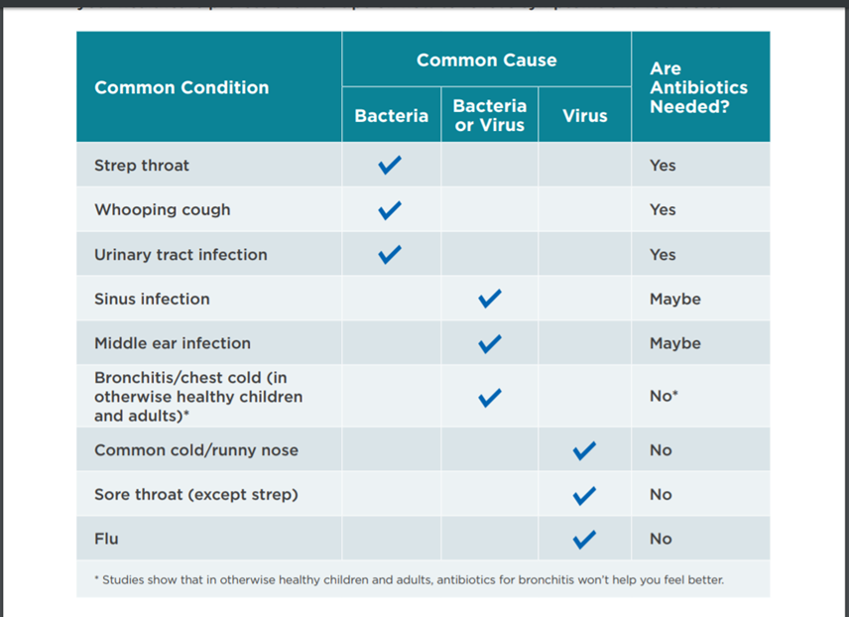
Are antibiotics needed?
https://www.cdc.gov/antibiotic-use/community/pdfs/aaw/AU_viruses-or-bacteria-Chart_508.pdf

Slide 18
Notes:
https://www.cdc.gov/antibiotic-use/community/pdfs/aaw/AU_Can-I-feel-better-without-antibioticsInfographic_8_5x5_5_4_508.pdf

Slide 19
Notes:
https://www.cdc.gov/antibiotic-use/community/pdfs/aaw/AU_Do-antibiotics-have-side-Infographic_8_5x5_5_2_508.pdf

Slide 20
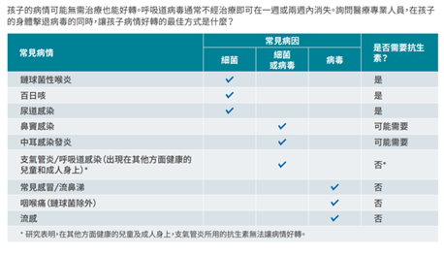
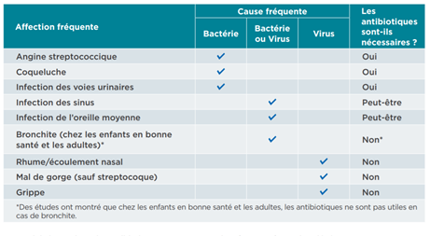
Notes:
https://www.cdc.gov/antibiotic-use/community/pdfs/Improving-Antibiotic-Use-Chinese-S-508.pdf

Slide 21
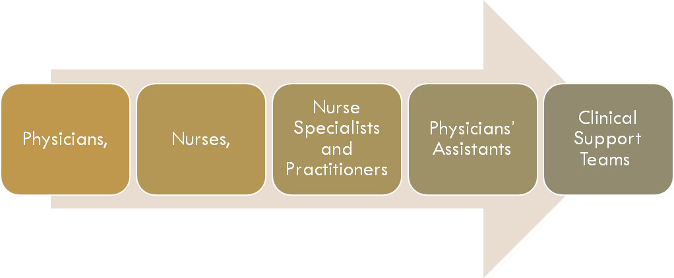
Healthcare professionals

Slide 22
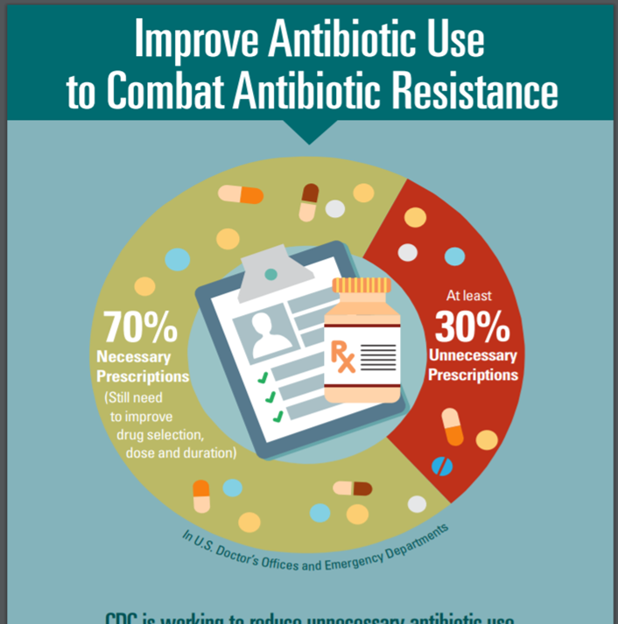
Current role of
Healthcare professionals
Notes:
https://www.cdc.gov/antibiotic-use/community/pdfs/16_265113-b_antibioresis_infographic_508.pdf

Slide 23
Steps for provider to reduce antibiotic-resistance
Infection control practices
Judicious use of antibiotics
Frequent and timely communication among health care providers
Develop antimicrobial stewardship program to make clinical decision and this teams consist of physicians, pharmacists, clinical care staff and microbiologists
Notes:
http://www.myrolematters.com/stakeholders.html

Slide 24
Animal Safety Professionals
http://www.myrolematters.com/stakeholders.html

Slide 25
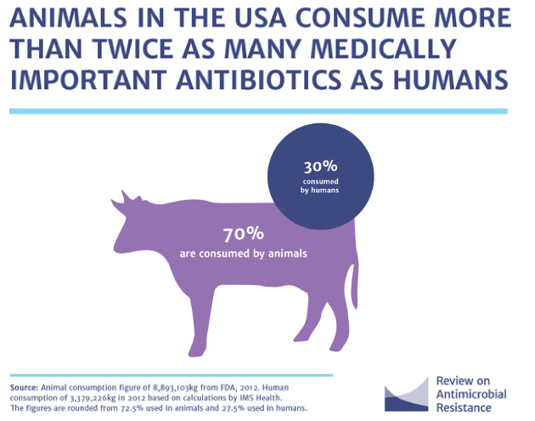
Global Problem

Slide 26
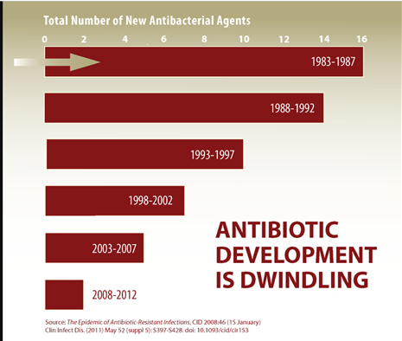
Policy Maker
Notes:
https://www.cdc.gov/antibiotic-use/community/images/materials/anti-dev.png

Slide 27
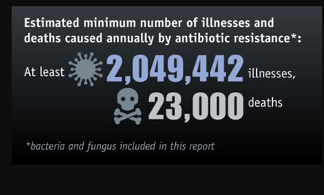
Current Health Issue
https://www.cdc.gov/antibiotic-use/community/images/materials/ar-deaths.jpg
Notes:
https://www.cdc.gov/antibiotic-use/community/images/materials/ar-deaths.jpg

Slide 28
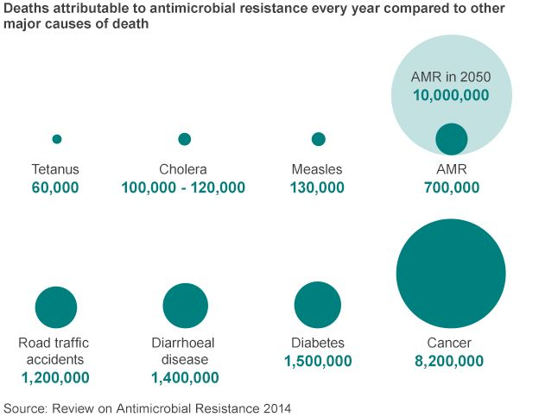
Future Health Issue
https://www.bbc.com/news/health-30416844

Slide 29
Plan for Financing Our Program
U.S. Department of Health & Human Services
CDC- Public Health System Financing
President’s Budget
Prevention and Public Health Fund
Local:
New York State Department of Health
Fund for Public Health in New York City
Notes:
Farhana

Slide 30
Inputs Needed To Make The Intervention Work.
Time: In order to develop an effective intervention, it will take about 6 months.. This will give us time to form a blueprint of our intervention that includes the time needed to collect our research/data, to form a diverse effective team that includes members from different professional backgrounds including physicians, microbiologist, pharmacists and more.
Money: The intervention will be funded by a grant supplied by the New York State Department of Health. Our total budget for the intervention is 20,000. This number has been calculated after considering:
-Funding for materials and supplies for the intervention
Ex: surveys, posters, printing, brochures
-Staff
-Facility
Physical space: An office space will be rented using the budget money to run the
intervention.
Notes:
Maria

Slide 31
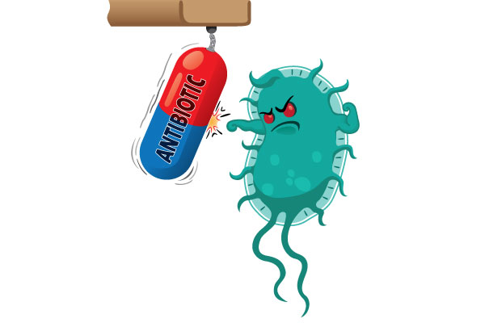
The Actual Intervention:
What exactly is involved? The intervention itself will include our mission, our strategies, who our population of interest is along with what proposed changes of actions we are aiming for. The intervention will be implemented in the New York Tri State area and will run for 1 year. If shown to effective and gains recognition, then we can obtain more grants to expand to other regions. The intervention will be purposed to the population using posters and wallpapers that can be displayed in healthcare organizations specifically physician offices that specializes in primary care. We will also be setting up informational stands for the public in different locations throughout the city by providing educational brochures along with having physicians and microbiologist on site to answer any questions people may have.
How many sessions:
Public educational stands will be set up, with a total of 5 sessions held throughout the year and each session will be held for 2 hours.
How many times per week/month/year:
Each session will be held every two months and these public sessions will be held throughout all 5 boroughs in the New York Tri State area, mainly in regions in busy areas where we can reach the most people.
Notes:
Maria

Slide 32
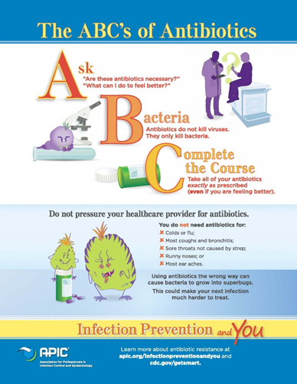
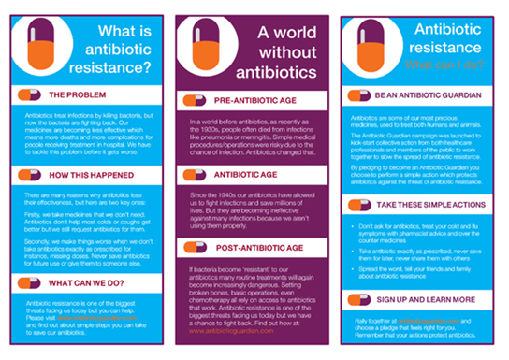
Flyers and Brochures
Notes:
Maria

Slide 33
Why Primary care?
We want to reach the population where antibiotics are prescribed the most. According to the CDC, in just 2015 alone 269 million antibiotics were dispensed from outpatient pharmacies in the United States. And from this 30% were found to be unnecessary. When we took a closer look, it was found that antibiotics are prescribed the most in primary care specialties, specifically in family medicine.
Notes:
Maria

Slide 34
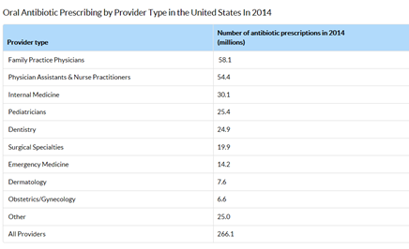
Notes:
Maria
Source: https://www.cdc.gov/antibiotic-use/stewardship-report/outpatient.html

Slide 35
How We Plan To Evaluate Our Program
CDC Annual Reports on Outpatient Antibiotic Use (https://gis.cdc.gov/grasp/PSA/AUMapView.html)
Reports annually on number and type of antibiotics prescribed per 1000 people by state
Development of patient surveys to administer to patients to compare beliefs on antibiotics before & 1 year after implementation of program.Examples of questions include :
Have you taken an antibiotic in the past year? If so, what did you take it for?
True or false → Antibiotics kill bacteria, Antibiotics kill viruses, Antibiotics will make me feel better if I have a cold or the flu
Do you believe there are any harms associated with antibiotic use? If so, what kind? If no, why not?
Is it okay to use antibiotics given to you by a friend or family member who had a similar illness? (http://apps.who.int/medicinedocs/documents/s22245en/s22245en.pdf)
Data currently exists on volume of antibiotics prescribed, but not on their appropriate use, so potentially could survey insurance companies on number of antibiotics linked to ICD-10 codes of URI, bronchitis, pharyngitis, influenza, etc.
Notes:
Genna

Slide 36
Maintenance & Funding...
If statistics after 1 year show decrease in rate of antibiotic prescriptions could present findings to CDC in regards to how it would help their Antibiotic Resistance Solutions Initiative and ask for funding
Can also present findings to Association for Professionals in Infection Control & Epidemiology (APIC), WHO, FDA who also have initiatives for antibiotic resistance
If program is successful, healthcare providers will experience less time spent on having to education patients on antibiotics and less antibiotic-related complications, thus will be more likely to participate in our program and promote our educational materials (i.e. patient handouts, information posters in offices, etc.)
Health insurance companies may also want to participate due to having to cover less antibiotic-related complications and antibiotic resistant infections
Notes:
Genna

Slide 37
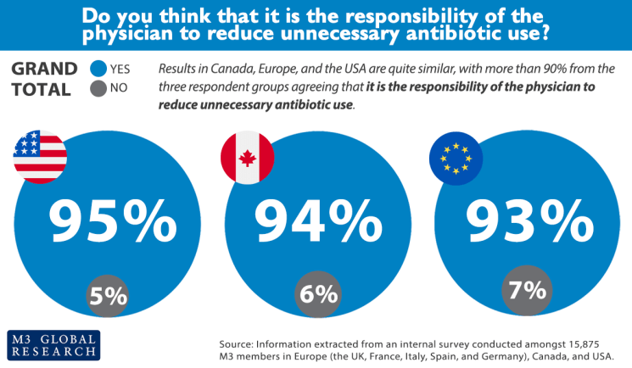
Planning for Failure… What to do if our intervention is unsuccessful?
Simplify educational information
Enlarge target population (i.e. from PCP and community health centers to specialists, hospitals, etc.)
Fear tactics → Such as the case with vaccines, switch from informing on medical necessity to informing on health dangers (i.e. graphic pictures of cancer on cigarettes in other countries)
Look back to healthcare providers to implement more judicious guidelines for antibiotic prescriptions
Encourage peer review in hospitals and private offices
Switch from “wait and see” prescriptions, which also depend on patient understanding of antibiotics, to delayed prescriptions (i.e. If you’re not feeling better, call clinician or go back for another visit)
https://m3globalresearch.blog/2017/08/30/overuse-unnecessary-antibiotics/
Notes:
Genna

Slide 38
https://www.youtube.com/watch?v=dETK7Jc-XWA&app=desktop

